Slide 1
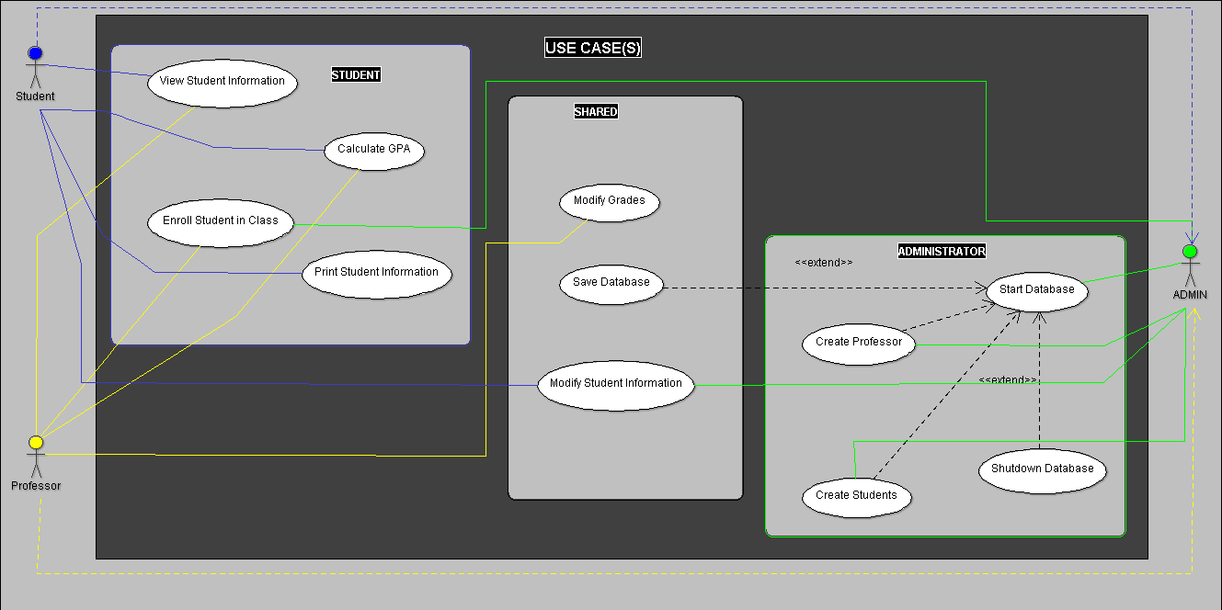

Slide 2
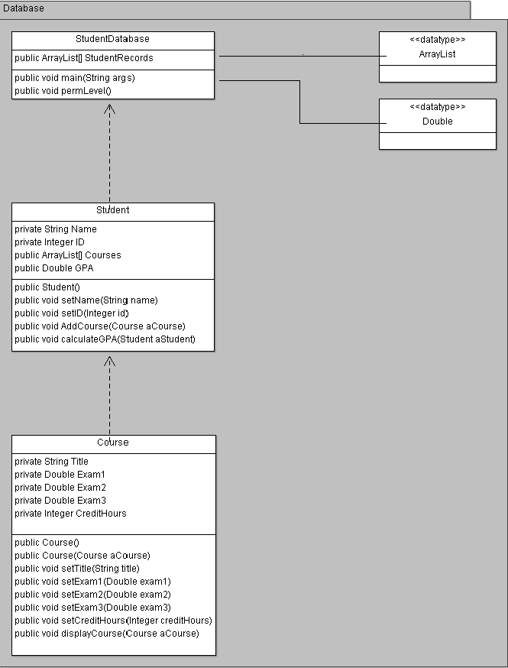
Call permLevel(), select permission level to access the database.
While loop holding database in memory.
No writing to plain text file until “saveDatabase()” is called.
If in correct permission mode newDatabase() can be called, if not the user has the open to view (STUDENT), or view and modify information (PROFESSOR). Only ADMIN can modify the structure of the database.

Slide 4
SPMP document outline:
Project overview
Project summary
Constraints (time constraints)
Project Organization
Role and responsibilities of each team member
Project responsibilities (describe each phase of the project)
Maybe create a process model?
Project Schedule
Team meetings (In class)
Work breakdown
Risk Management
Common risks
Risks in each phase (design, implementation, testing, ect.) and the prevention of each risk.
Technical Process
The methods, tools, and techniques that are used during the project. (UML diagrams, what type of programming language, ect.

